Slide 1
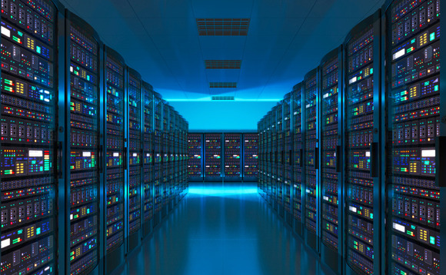
Web Servers and Applications
By: Anikat, Dylan, Zakariya and Kudhrit

Slide 2
What we will be talking about
Client Server Model/Application On The Internet
Internet Server Hardware
Internet Server Software
Internet Servers and Desktop PCs, Similarities and Differences
Big Companies VS. Small Companies
HTTP VS. HTTPS
FTP and SMTP
Web Servers
Database Servers
Email Servers
Other Transaction Servers
Online Games

Slide 3
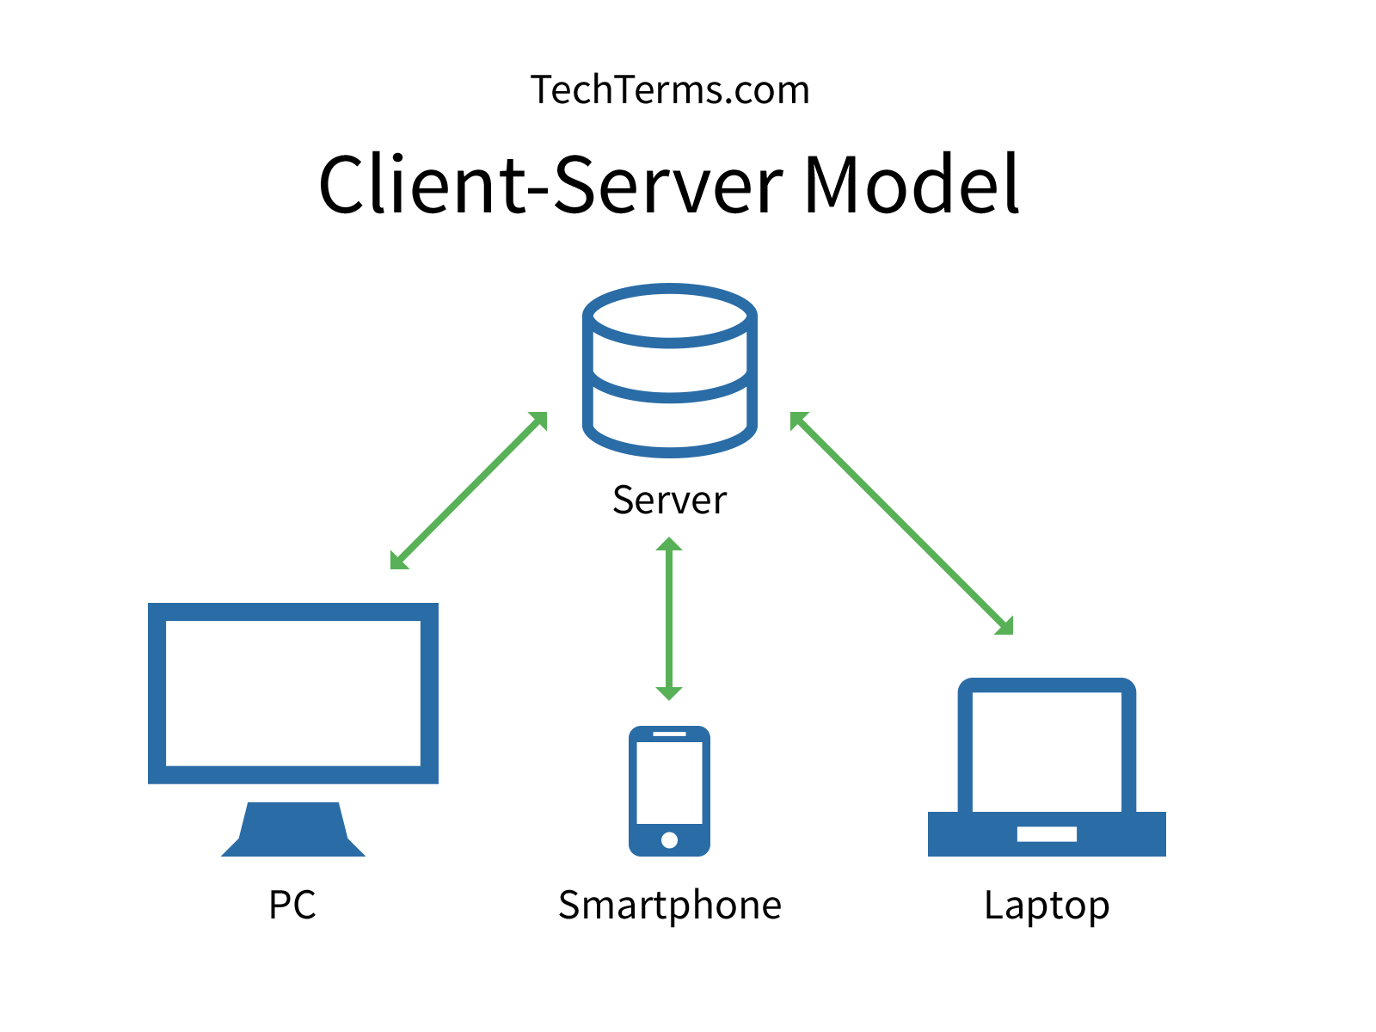
Client Server Model
It is a communication framework distributed for network processes among service requesters, clients, and service providers.
When you send a text message It is a server that it is being sent on, but client used to send it.

Slide 4

Applications On The Internet
Client software is not always needed when accessing applications on the internet, sometimes you can use a web browser to access applications, however client software does exist for most applications that are server based or on the internet.
Many service applications operate on private servers in places run by the service provider, whereas the application client software are easily accessible and downloadable from the website of the provider and in many cases, from other sources on the internet as well.

Slide 5
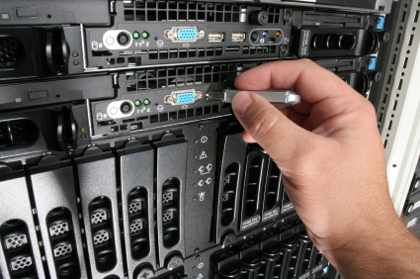
Internet Server Hardware
Web server computers have more memory, larger hard disk drives, and faster processors.
Blade servers is placing small server computers on a single computer board.
Virtual server (virtual host) would maintain more than one server on one machine.
One approach to support large scale servers is to have few very large, powerful, but expensive computers/servers.
Alternative approach is to have a lot of cheap servers/computers
(Basically more advanced computers built to focus on hosting services to allow multiple users at the same time).

Slide 6
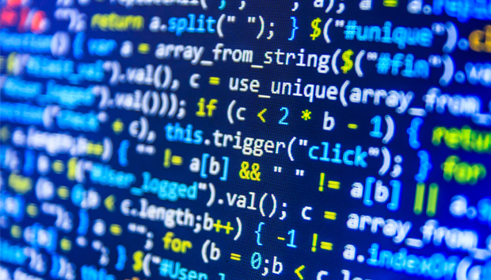
Internet Server Software
The operating system of an internet server is not easy to pick. There are specific operating systems for what the server would be mainly used for. Server software is primarily built to interact with a server’s hardware infrastructure that includes the processor, memory, storage, input, output and other communication ports.

Slide 7
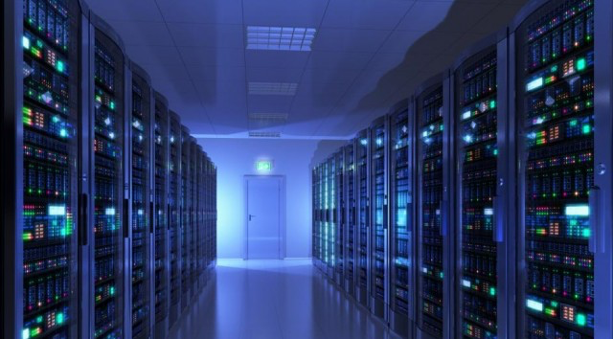
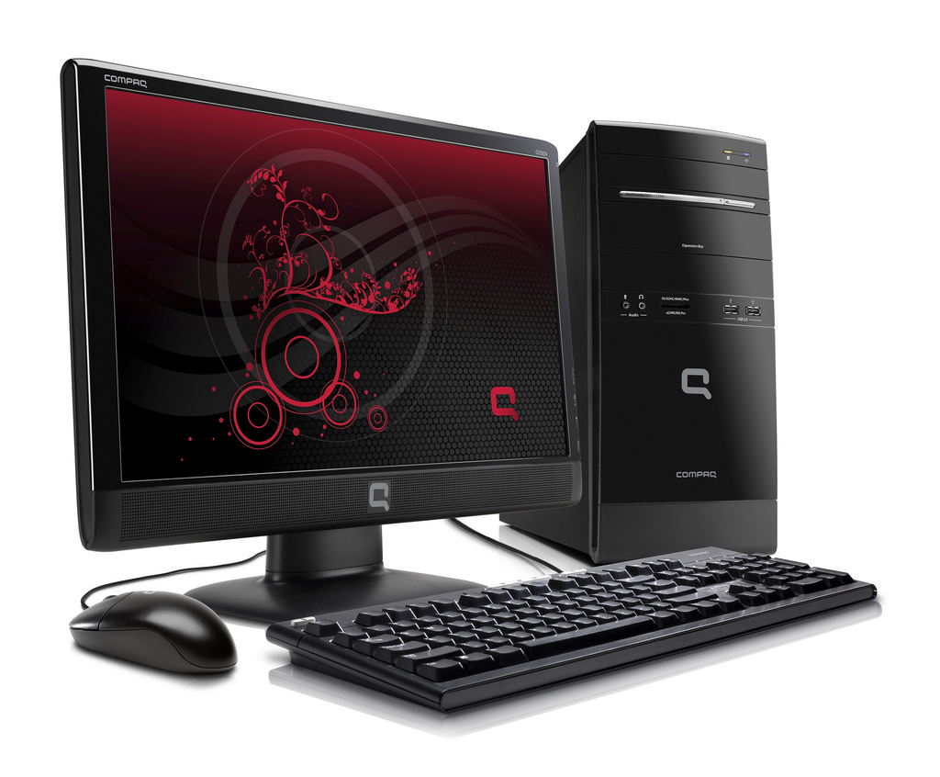
Internet Servers and Desktop PCs, Similarities and Differences
The similarities in hardware to internet servers and desktop PCs is that they perform similar tasks and involve much of the same hardware and software.
The difference between them is that a desktop PC is used for personal use whereas an internet server is used to host a service to many people at the same time.
Internet server software are similar to desktop PC software because they both allow for ease of access to services to users.
The difference in software is that a desktop PC software allows the user to use many different softwares (OS), and server software allow many users to access one service/software.

Slide 8
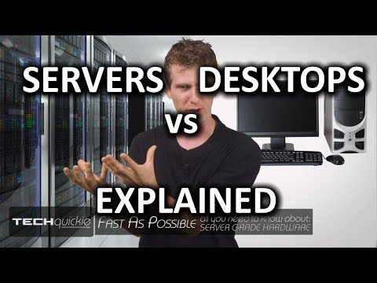
Desktop VS. Servers
https://www.youtube.com/watch?v=ByI1PHMcPJQ

Slide 9

Big Companies VS. Small Companies
Big companies have large rooms fully dedicated to hold server computers, whereas smaller services can just use a single desktop computer to host a service.
In a small company the server would be a low-end server that is affordable and manageable in a small business. Small business servers are for about a dozen employees and a small business server is often used to manage multiple network services which are email, threat management, file sharing, and data backups.
In a large company they would have many servers to do only one task. These separate servers can be print servers, and data servers which would only do the task that they were assigned.

Slide 10
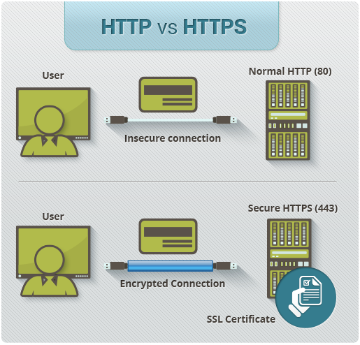
HTTP VS. HTTPS
Hypertext Transfer Protocol is an application layer protocol which is basically the protocol followed for information sent from a user’s web browser to the website they are visiting, this allows the information to be sent in plain text which means that if it were intercepted, it could easily be taken and understood.
Hypertext Transfer Protocol Secure is similar to HTTP, except this encrypts information before sending it to the website, making it difficult for interceptors to take the information as it could require complex decrypting.

Slide 11
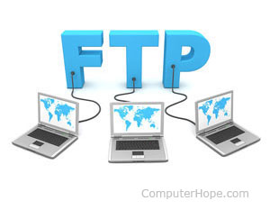

FTP and SMTP
FTP - File Transfer Protocol, this is a language allowing software to communicate across ends of a connection, not as secure as Https but is more often used for business reasons with colleagues, clients, and other companies.
SMTP - Simple Mail Transfer Protocol, it is used when an email is delivered from an email software client to an email server or from one email server to another email server.

Slide 12

Web Servers
Function of a Web Server
Client’s browser divides URL to different parts such as, address, path name, and protocol.
DNS (Domain Name System) translates the domain name into the corresponding IP address
The browser decided which protocol should be used for the situation (Client).
The application client/browser sends GET request to web server to retrieve address it has been given, verifies the address, finds the necessary files, runs the appropriate scripts, exchanges cookies if necessary and returns the information back to the browser.
Browser converts the data to HTML and displays the results to the user, if it is not found, an error message is sent to the client and the browser.
Hardware and Software for a Web Server
Most low end web servers would need two 1.6 Ghz CPUs, 3.5 GB ram and a hard disk drive of at least 40 GB. The software needed is internet information services (IIS) 6,7, 7.5, and 8. I would also need windows PowerShell 2, 3, and 4. The operating system would depend on the Internet Information Service that is being used.
The different type of web servers that are used in companies are Internet Information Services (IIS) which is used for Microsoft and Sun Java System Web Server which is used for Sun Microsystems

Slide 13
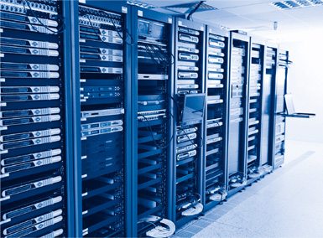
Database Servers
Operate large quantities of data by inputting, storing, retrieving, and managing that data.
Provide one set of software programs to all users with access to all the data.
What special hardware and software is required by a “Database Server”?
The Following should be taken into account when looking for suitable hardware and while creating or buying software:
High-traffic or low-traffic webshop
Number of visitors per day/month
Maximum number of simultaneous visitors
Maximum number of order lines in the shopping basket
Number of simultaneous orders
Size and complexity of the products catalog (number of products, product categories, attributes)
Number of articles in the webshop
Number of search queries
Size of the database
The hardware needed for most low end Database Servers is four 1.6 GHz CPUs, 7 GB of RAM, and at least 40 Gb of free space in a hard disk drive.
The software for low end database servers can be Microsoft SQL Server 2008 R2, Microsoft SQL Server 2008 with Service Pack 1 or later, and Microsoft SQL Server 2005 with Service Pack 2 or later etc.

Slide 14
Database Servers Compared to Web and Transaction Servers
They are related because they all involve manipulating some amount of data, for database servers, they must manipulate significantly more data than the other 2 types of servers as it holds more types of information compared to web servers not having to hold as diverse information in the context of types of data.
They are also different because they manipulate the data differently because database servers manipulate data for one user to be able to access efficiently, whereas transaction servers allow real time data to be exchanged and manipulated with 2 or more parties, and web servers allow multiple people or even users on their own to manipulate/access data.

Slide 15

Email Servers
Allows Users to:
Send emails to other email addresses
Receive sent emails to user’s address
Send and receive emails from most other email servers
Receive promotional emails (Advertisements) sent in mass bunches, spam, etc. without needing explicit consent by the user.
Hardware Required:
Mail Host - Machine designated as main mail machine on the network, where other systems on the site forward mail that cannot be delivered is sent.
Mailboxes are single files that contain emails for a user, A mail server is any system that maintains mailboxes within it.
A Mail Gateway is a machine that handles connections between networks that run different communications protocols or communications between different networks that use the same protocol
Software Required:
Mail User Agent program that acts as the interface between the user and mail transfer agent.
Mail Transfer Agent responsible for the routing of mail messages
A Local Delivery Agent is a program that implements a mail delivery protocol
The Mail Address contains the name of the recipient and the system to which the mail message is delivered.
SMTP is the standard mail protocol that is used on the Internet.

Slide 16
Types Of Email Servers
Web-Based Email - Most common type of server used by Google and Yahoo, etc.
POP3 (Post Office Protocol 3) Email Servers - Used by Internet Service Providers, to provide users with email accounts with their services.
IMAP (Internet Message Access Protocol) - alternative to POP3, often used by business email accounts because it allows users to preview, delete and organize emails before they transfer them from the email server to their computers. Also leaves copy of email on server until user decides to delete them.
SMTP (Simple Mail Transfer Protocol) - Work alongside other mail servers and are in charge of handling the email that users send out from their email clients.

Slide 17

Transaction Servers
A Transaction Server is a specialized type of server that manages the processes of software based transactions. It manages transactions on an application and/or database on a network or on the internet.
This is different from a web server because this is specially tailored for transaction process management whereas web servers are more general purpose for the websites and the like that they are used for.
Examples:
Video game microtransactions
Netflix/Crunchyroll, etc. subscriptions
Buying applications/software online
Skype call hours
Online Banking
PayPal

Slide 18

Online Games
Network Services Used In Online Games:
DNS (Domain Name System) - Used by game owners to track users and be able to IP ban them if they violate terms of service
Authentication servers - identify, authenticate, and provide users with account profiles by taking in and authenticating Email addresses and can log usage data on those accounts
File Server - For many files concerning things like maps, user/character data, etc.
Time Service - For games that display the current time in the client
World Wide Web - Allows online games to be played directly on the web browser itself on a WWW domain.
Instant Messaging - For games (Most that exist now) to allow users to communicate with other users through text. Sends these messages through the server at the game developer’s building.
Network Services Used In Client Software
Voice Over IP - In-Client service that allows you to communicate with other user’s through speech.
Video On Demand - Allows videos imbedded by developers to be played directly on the client.

Slide 19
Thank You For Listening!

Slide 20
Works Cited
Beal, Vangie. “Small Business Server.” What Is a Small Business Server? Webopedia Definition, www.webopedia.com/TERM/S/small_business_server.html.
Beal, Vangie. “Is Server Different from a Desktop PC?” How Is a Server Different from a Desktop? Webopedia.com, www.webopedia.com/DidYouKnow/Hardware_Software/difference_between_server_and_desktop.html.
“E-Commerce.” Web Servers Hardware and Software, www.dcs.bbk.ac.uk/~gmagoulas/Web Server Hardware and Software.pdf.
“FUNCTIONS OF A WEB SERVER.” Cloud VPS and Dedicated Hosting Knowledgebase, kb.bodhost.com/functions-of-a-web-server/.
“Functions of Database Server.” Scribd, Scribd, www.scribd.com/document/252060086/Functions-of-Database-Server.
Admin. “HTTP vs. HTTPS – What's the Difference?” Easynews Blog, blog.easynews.com/http-vs-https-whats-the-difference/.
McManaway, Erin. “Types of Email Servers.” It Still Works, 13 Apr. 2017, itstillworks.com/types-email-servers-6148964.html.
Nield, David. “What Does FTP Stand for When Using a Computer?” Small Business - Chron.com, Chron.com, 21 Nov. 2017, smallbusiness.chron.com/ftp-stand-using-computer-70065.html.
“Setup Web and Database Server.” Hardware Requirements for Web and Database Servers, help.sana-commerce.com/sana-commerce-83/installation/setup-web-and-database-server/hardware-requirements-for-web-and-database-servers.
“Software and Hardware Components of Mail Services.” Software and Hardware Components of Mail Services (System Administration Guide: Resource Management and Network Services), docs.oracle.com/cd/E19683-01/817-0204/6mg168c5t/index.html#mailrefer-68.
Techquickie. “Servers vs Desktop PCs as Fast As Possible.” YouTube, YouTube, 18 June 2014, www.youtube.com/watch?v=ByI1PHMcPJQ.
Tutorials Point. “Web Server Types.” Www.tutorialspoint.com, Tutorials Point, 8 Jan. 2018, www.tutorialspoint.com/web_developers_guide/web_server_types.htm.
“What Is a Mail Server and How Does It Work?” What Is a Mail Server and How Does It Work? (Article), www.samlogic.net/articles/mail-server.htm.
“What Is the Client-Server Model? - Definition from Techopedia.” Techopedia.com, www.techopedia.com/definition/18321/client-server-model.
“What Is a Transaction Server? - Definition from Techopedia.” Techopedia.com, www.techopedia.com/definition/16211/transaction-server.
Zaib, ŐŔaṉģ. “Common Network Services.” LinkedIn SlideShare, 10 Apr. 2014, www.slideshare.net/zaib001/common-network-services.

